Slide 1
GOOD EVENING ONE AND ALL

Slide 2

CRYPTOGRAPHY USING LINEAR ALGEBRA
MATHEMATICS FOR INTELLIGENT SYSTEMS
BY
Abijith

Slide 3
What is Cryptography?
“CRYPTOGRAPHY” is the science of protecting data and communications.
It is a study of methods of sending messages in a disguised form so that only intended recipients can remove disguised form and read the message.
It can also be explained as when two parties wants to communicate each other and avoiding third party understanding this communication and they should fall into wrong hands.

Slide 4
Project analysis slide 2
TERMINOLOGY
USED IN
CRYPTOGRAPHY
1
2
PLAIN TEXT
CIPHER TEXT
CRYPTOGRAPHY
3
4
ENCRYPTION
DECRYPTION

Slide 5
Project analysis slide 3
Explanation of Terms
PLAIN TEXT
DECRYPTION
CIPHER
TEXT
ENCRYPTION
PLAIN TEXT REFERS TO MESSAGE BEFORE ENCRYPTION,IT IS MESSAGE OR INFORMATION THAT IS BEING ENCRYPTED.
ENCRYPTION IS PROCESS OF CONVERTING NORMAL MESSAGE INTO DISGUISED FORM
DECRYPTION IS REVERSE OF ENCRYPTION THAT IS CONVERTING THE DISGUISED FORM INTO ITS ORIGINAL FORM
CIPHER TEXT IS ALSO KNOWN ENCRYPTED MESSAGE OR THE MESSAGE CREATED AFTER USING CIPHER
.

Slide 6
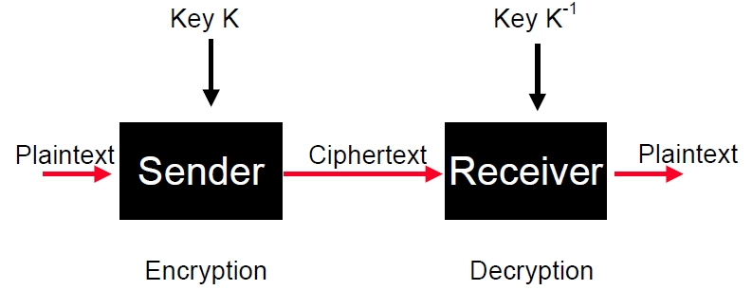
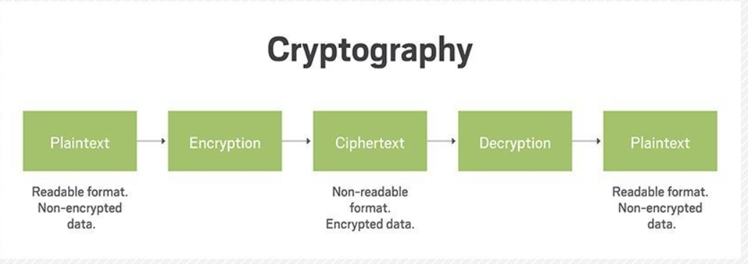
For clear understanding

Slide 7
WHAT IS CIPHER ???
A cipher is a method of hiding words of text by replacing the original message with other letters and numbers. It is done by using a key this will be known only to sender and receiver.
TYPES OF CIPHERS
Substitution cipher
Caesar cipher
Hill cipher

Slide 8
Substitution cipher
Substitution cipher is a type of encryption in which characters of text are replaced by another letter or a number to encrypt a text sequence.
A | B | C | D | E | F | G | H | I | J | K | L | M | N | O | P | Q | R | S | T | U | V | W | X | Y | Z
C | S | E | A | I | 2 | 0 | 1 | 9 | U | G | D | O | N | H | P | B | M | W | Z | Y | X | L | K | J | R
we have given substitution for every letter and let's try an example.
Message is VISUALIZATION IS VITAL
Encrypted message is X9WYCD9RCZ9HN 9W X9ZCD

Slide 9
Caesar cipher
In Caesar cipher, we will shift each letter by a fixed unit
 |  |  | A | B | C | D | E | F | G | H | I | J | K | L | M | N | O | P | Q | R | S | T | U | V | W | X | Y | Z
A | B | C | D | E | F | G | H | I | J | K | L | M | N | O | P | Q | R | S | T | U | V | W | X | Y | Z | A | B | C
Here we shifted each letter by 3 units.
Message is ARTIFICIAL INTELLIGENCE
Encrypted message is DUWLILFLDOLQWHOOJHQFH (avoiding spaces)

Slide 10
Key math concepts used
Matrix multiplication
Inverse of a matrix
Modular arithmetic
Multiplicative inverse

Slide 11
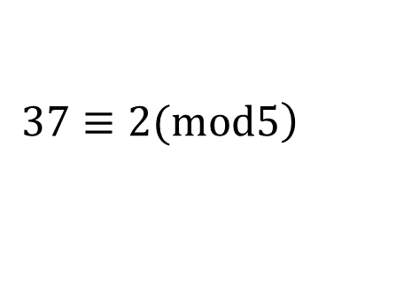
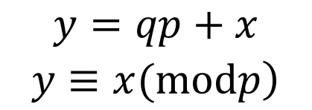
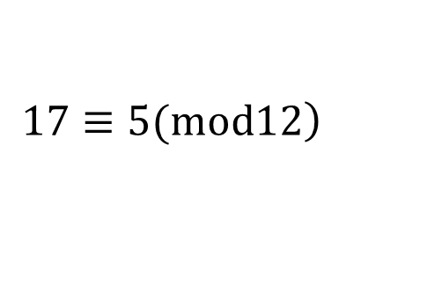
Modular arithmetic
Modular arithmetic is a system of arithmetic for integers, where values reset and begin to increase again, after reaching a certain predefined value, called the modulus or modulo denoted by “Zm”.
y is divided by p has remainder x and q belongs to some integer.
Example-1 37 – 2 is divisible by 5
Example-2
for representing 5pm in 24 hour format we use 17
$$\begin{matrix}y=qp+x \\ \left.y≡x(modp\right)\end{matrix}$$
$$\left.37≡2(mod5\right)$$
$$\left.17≡5(mod12\right)$$

Slide 12




Multiplicative inverse
Table for mod 7
×
0
1
2
3
4
5
6
$$\left.3^{−1}=5(Mod7\right)$$
0
0 | 0 | 0 | 0 | 0 | 0 | 0
0 | 1 | 2 | 3 | 4 | 5 | 6
0 | 2 | 4 | 6 | 1 | 3 | 5
0 | 3 | 6 | 2 | 5 | 1 | 4
0 | 4 | 1 | 5 | 2 | 6 | 3
0 | 5 | 3 | 1 | 6 | 4 | 2
0 | 6 | 5 | 4 | 3 | 2 | 1
1
$$\left.5^{−1}=3(Mod7\right)$$
2
3
$$\left.4^{−1}=2(Mod7\right)$$
4
5
$$\left.6^{−1}=6(Mod7\right)$$
6

Slide 13
Hill cipher
This system is called as hill cryptosystem, The key or cipher in this system is an invertible matrix of integers mod 26.
In Hill cipher cryptosystem, first we will assign numbers to represent
each letter of the alphabet.
A | B | C | D | E | F | G | H | I | J | K | L | M | N | O | P | Q | R | S | T | U | V | W | X | Y | Z
0 | 1 | 2 | 3 | 4 | 5 | 6 | 7 | 8 | 9 | 10 | 11 | 12 | 13 | 14 | 15 | 16 | 17 | 18 | 19 | 20 | 21 | 22 | 23 | 24 | 25

Slide 14
Example
Message: MIS PROJECT TODAY
Key: D K U U J R J E R
ENCRYPTION:
Cipher text = (plain text x Key)Mod 26
DECRYPTION:
Plain text = (cipher text x Key⁻¹)Mod 26
NOTE : “KEY MUST BE INVERTIBLE”

Slide 15



Now put our message in matrix form
CIPHER TEXT
Encryption
$$\left[\begin{matrix}M & I & S \\ P & R & O \\ J & E & C \\ T & T & O \\ D & A & Y\end{matrix}\right]=\left[\begin{matrix}12 & 8 & 18 \\ 15 & 17 & 14 \\ 9 & 4 & 2 \\ 19 & 19 & 14 \\ 3 & 0 & 24\end{matrix}\right]$$
$$key=\left[\begin{matrix}3 & 10 & 20 \\ 20 & 9 & 17 \\ 9 & 4 & 17\end{matrix}\right]$$
$$=\left[\begin{matrix}12 & 8 & 18 \\ 15 & 17 & 14 \\ 9 & 4 & 2 \\ 19 & 19 & 14 \\ 3 & 0 & 24\end{matrix}\right]×\left[\begin{matrix}3 & 10 & 20 \\ 20 & 9 & 17 \\ 9 & 4 & 17\end{matrix}\right]Mod 26$$

Slide 16




Encryption
$$=\left[\begin{matrix}358 & 264 & 682 \\ 511 & 359 & 827 \\ 125 & 134 & 282 \\ 563 & 417 & 941 \\ 225 & 126 & 468\end{matrix}\right]Mod 26$$
$$=\left[\begin{matrix}20 & 4 & 6 \\ 17 & 21 & 21 \\ 21 & 4 & 22 \\ 17 & 1 & 5 \\ 17 & 22 & 0\end{matrix}\right]$$
Cipher text
$$\left[\begin{matrix}M & I & S \\ P & R & O \\ J & E & C \\ T & T & O \\ D & A & Y\end{matrix}\right]$$
$$\left[\begin{matrix}U & E & G \\ R & V & V \\ V & E & W \\ R & B & F \\ R & W & A\end{matrix}\right]$$
Before Encryption
After Encryption

Slide 17

Plain text = (cipher text x key⁻¹)Mod 26
To Find (key⁻¹)
(key⁻¹) = [Det(key)]⁻¹ x Adj(key)
Step-1 : find determinant of key
Step-2 : find adjoint of key
Det(key) = = (-1635)Mod 26 = (-23)Mod 26 = 3
[Det(key)]⁻¹ = 3⁻¹ Mod 26 = 9
Decryption
$$\left[\begin{matrix}3 & 10 & 20 \\ 20 & 9 & 17 \\ 9 & 4 & 17\end{matrix}\right]Mod 26$$

Slide 18




For Adjoint of key
Transpose of key:
Minor of key:
Cofactor of key:
Decryption
$$Trans(key)=\left[\begin{matrix}3 & 20 & 9 \\ 10 & 9 & 4 \\ 20 & 17 & 17\end{matrix}\right]$$
$$\left[\begin{matrix}a_{11} & a_{12} & a_{13} \\ a_{21} & a_{22} & a_{23} \\ a_{31} & a_{32} & a_{33}\end{matrix}\right]$$
$$=\left[\begin{matrix}85 & 90 & −10 \\ 187 & −129 & −349 \\ −1 & −78 & −173\end{matrix}\right]$$
$$\left[\begin{matrix}+ & − & + \\ − & + & − \\ + & − & +\end{matrix}\right]→\left[\begin{matrix}85 & −90 & −10 \\ −187 & −129 & 349 \\ −1 & 78 & −173\end{matrix}\right]$$

Slide 19







Decryption
(key⁻¹) = [Det(key)]⁻¹ x Adj(key)
Plain text = (cipher text x key⁻¹)Mod 26
$$9∗\left[\begin{matrix}85 & −90 & −10 \\ −187 & −129 & 349 \\ −1 & 78 & −173\end{matrix}\right]Mod26$$
$$=\left[\begin{matrix}765 & −810 & −90 \\ −1683 & −1161 & 3141 \\ −9 & 702 & −1557\end{matrix}\right]Mod 26$$
$$=\left[\begin{matrix}11 & 22 & 14 \\ 7 & 9 & 21 \\ 17 & 0 & 3\end{matrix}\right]$$
$$=\left[\begin{matrix}350 & 476 & 382 \\ 691 & 563 & 742 \\ 633 & 498 & 444 \\ 279 & 383 & 274 \\ 341 & 572 & 700\end{matrix}\right]Mod 26$$
$$=\left[\begin{matrix}12 & 8 & 18 \\ 15 & 17 & 14 \\ 9 & 4 & 2 \\ 19 & 19 & 14 \\ 3 & 0 & 24\end{matrix}\right]$$
$$=\left[\begin{matrix}20 & 4 & 6 \\ 17 & 21 & 21 \\ 21 & 4 & 22 \\ 17 & 1 & 5 \\ 17 & 22 & 0\end{matrix}\right]$$
$$×\left[\begin{matrix}11 & 22 & 14 \\ 7 & 9 & 21 \\ 17 & 0 & 3\end{matrix}\right]Mod 26$$
Plain text

Slide 20
MATLAB CODE
clc;clear;close all;
disp('***********************************************************************');
disp(' Cryptography ');
disp('***********************************************************************');
text=input('Enter The plain Text : ','s'); %Input for the plain text
n = input('Enter the key size : (Must be 4,9,....) : ');
n=sqrt(n);
upperString=upper(text); %Converting the string to capital letters
charText=char(upperString); %Converting from string to char
Actualtext=charText-65; %Substracting 65 to obtain the letters in the range of 0-25
jk=Actualtext;
if(rem(size(Actualtext),n)==[1 0])
Message=reshape(Actualtext,n,length(Actualtext)/n);
Message = [Message]';%Converting a row matrix to a matrix with n columns
else
Actualtext=[Actualtext 25]; %Adding an extra dummy character at the end
Message=reshape(Actualtext,n,length(Actualtext)/n);
Message = [Message]';
end

Slide 21
theKey=0;
for i=1:(n^2)
key=input('Enter the key: ');
theKey=[theKey key];
end
realkey=theKey(2:end);
rrealkey=realkey+65;
Key=char(rrealkey)
Actualkey=reshape(realkey,n,n)’;
if(det(Actualkey) ~= 0)
Encmessage=Message*Actualkey;%Multiplying the plain text with the key
Encmessage=mod(Encmessage,26);%Finding the mod of the multiplied matrix
Encmessage=[Encmessage]';
encmatrix=reshape(Encmessage,1,length(Actualtext));%Changing the matrix back to row matrix
encmatrix=encmatrix+65;
Encrypted=char(encmatrix)
else
disp('The key matrix is not invertible');
end

Slide 22
%Decrypting
j=mod(det(Actualkey),26);
for b = 1:26
d(b)=j*b;
h(b)=rem(d(b),26);
end
% m =[3 10 20;20 9 17;9 4 17;]
h=uint8(h);
m=find(h==1);
if(m ~=0)
invk=m.*adjoint(Actualkey);
else
disp('Enter Another Key');
return;
end
Encmessage=[Encmessage]';
decmsg=Encmessage*invk; %Multiplying inverse with the encrypted message
decmsg=mod(decmsg,26);

Slide 23
decmsg=[decmsg]';
decmsg=reshape(decmsg,1,length(Actualtext));
decmsg=decmsg+65;
if(rem(length(jk),n)==0)
decmsg=uint8(decmsg);
v=find(decmsg==91);
decmsg(v)=65;
char(decmsg)
else
decmsg=decmsg(1:length(Actualtext)-1);
decmsg=uint8(decmsg);
v=find(decmsg==91);
decmsg(v)=65;
char(decmsg)
end

Slide 24
Application
There are many applications such as secure web browsing,
secure network communications, digital signatures.
WhatsApp is currently one of the most popular mobile messaging software.
The conversations and calls are ‘end-to-end’ encrypted. Once the client is registered, an encrypted session is created between two clients.
If for example client1 wants to send message to client2 the public keys of the client2 are retrieved from WhatsApp server, and this is used to encrypt the message.

Slide 25
Thank You

